Slide 1
5.4: Solving Systems Involving 3 Variables

Slide 2
I) Systems with 3 Variables: (x, y, z)
Goal: Reduce the system from 3 equations (3 variables) to 2 equations (2 variables)
  Find the LCM of “x”
  Multiply all equations by constant so that coefficients of “x” will be the same
  Add or subtract the equations to eliminate “x”
  Goal: Create two new equations, with only “y” and “z” variables
  Solve the system with 2 missing variables

Slide 3
Ex: Solve for x, y, and z
Coefficients of “x”
LCM: 6
Eliminate “x”
by Add/Subtract
2 Equations with
2 variables only
Solve for the other
2 variables
The solutions is at
(1.8, 3.2, 4)

Slide 4
Practice: Solve for x, y, and z
Coefficients of “z”
LCM: 2
Eliminate “z”
by Add/Subtract
2 Equations with
2 variables only
Solve for the other
2 variables
The solutions is at
(1, 2, 3)

Slide 5
Practice: for x, y, and z
Rearrange the
Equation
Coefficients of “y”
LCM: 6
2 Equations with
2 variables only
LCM: 120
Eliminate “y”
by Add/Subtract
Solve for the other
2 variables
The solutions is
at (3, -2, 0.5)

Slide 6
II) Word Problems:
Challenge: Set up the system from a word problem
Ex: Create the system of equations from the following word problem
The sum of triple the second and four times the third number is equal to the one plus triple the first number. The sum of the first number and triple the second is equal to 12. The sum of twice the first number, the second number, and five is equal to twice the third.

Slide 7
The daily profit of a clothing kiosk is determined by the equation , where “p” is the profit, and “x” is the cost of each t-shirt. If the t-shirt cost $10, the profit is $800. If the cost is $16, the profit is $992. If the cost is $20, the profit is $600. Find a, b, and c.

Slide 8
The daily profit of a clothing kiosk is determined by the equation , where “p” is the profit, and “x” is the cost of each t-shirt. If the t-shirt cost $10, the profit is $800. If the cost is $16, the profit is $992. If the cost is $20, the profit is $600. Find a, b, and c.

Slide 9
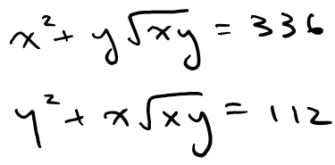
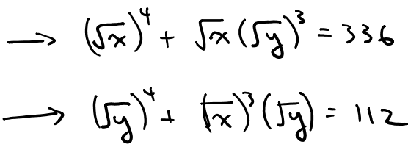
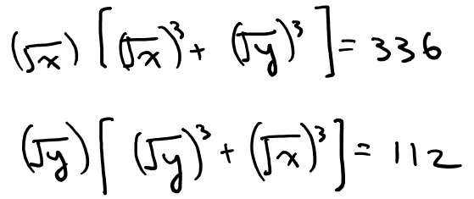
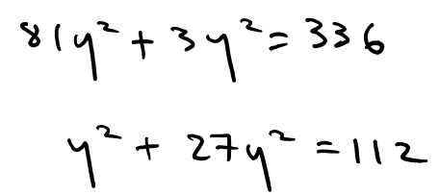
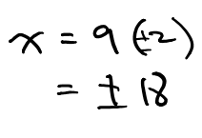
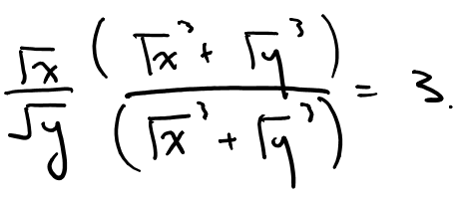
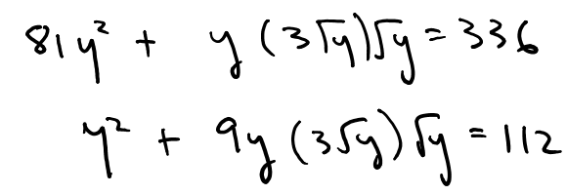
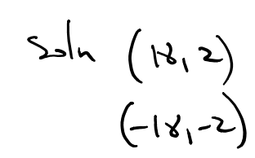
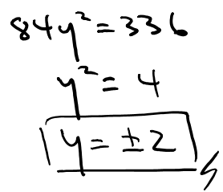
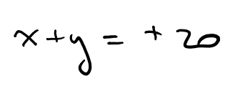
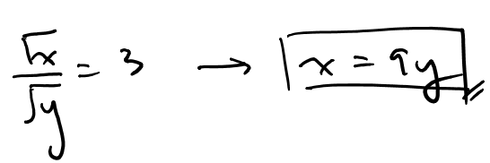
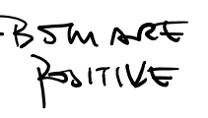
Challenge: Given that “x” and “y” are positive numbers and satisfy the following system of equations, Find the value of “x+y”

Slide 10
Challenge: For some function, f(x), where ‘a’,’b’,’c’, and d’ are integers, we are given the following:

Slide 11
Homework
Assignment 5.4

